Slide 1
EECT 121 Lab Notebook
Rachel Herman
Lab Partner: Jason Block
Professor Andy Bell
Created: 12/12/17

Slide 2
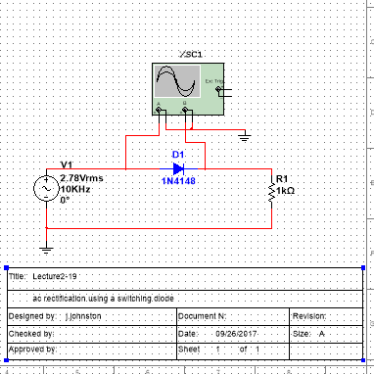
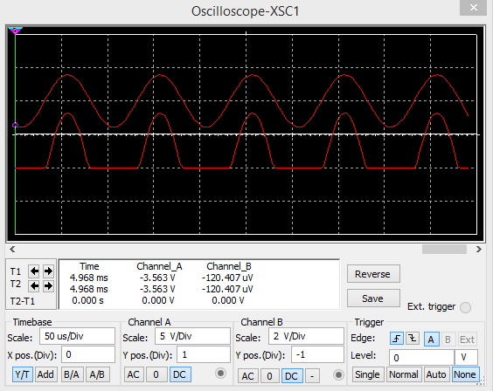
Lab 1 – Switching diode

Slide 3
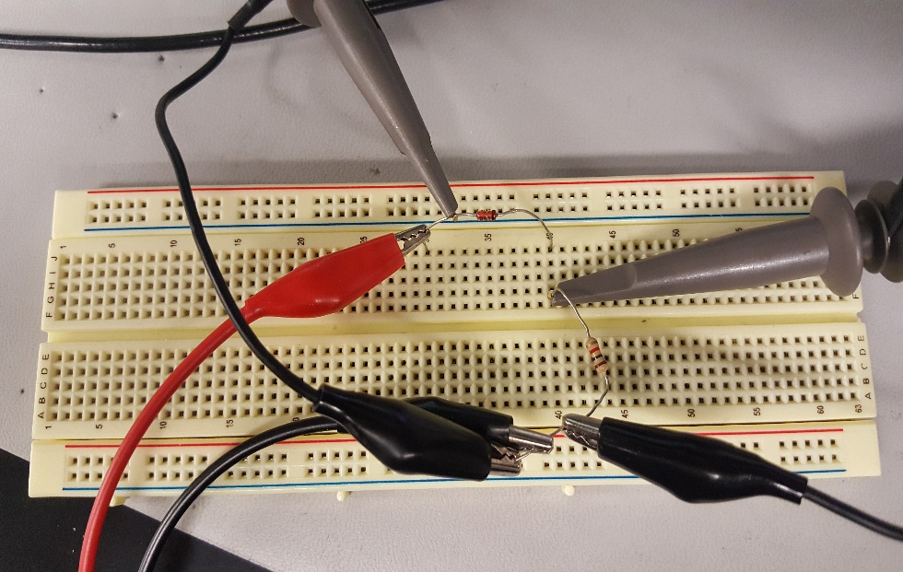
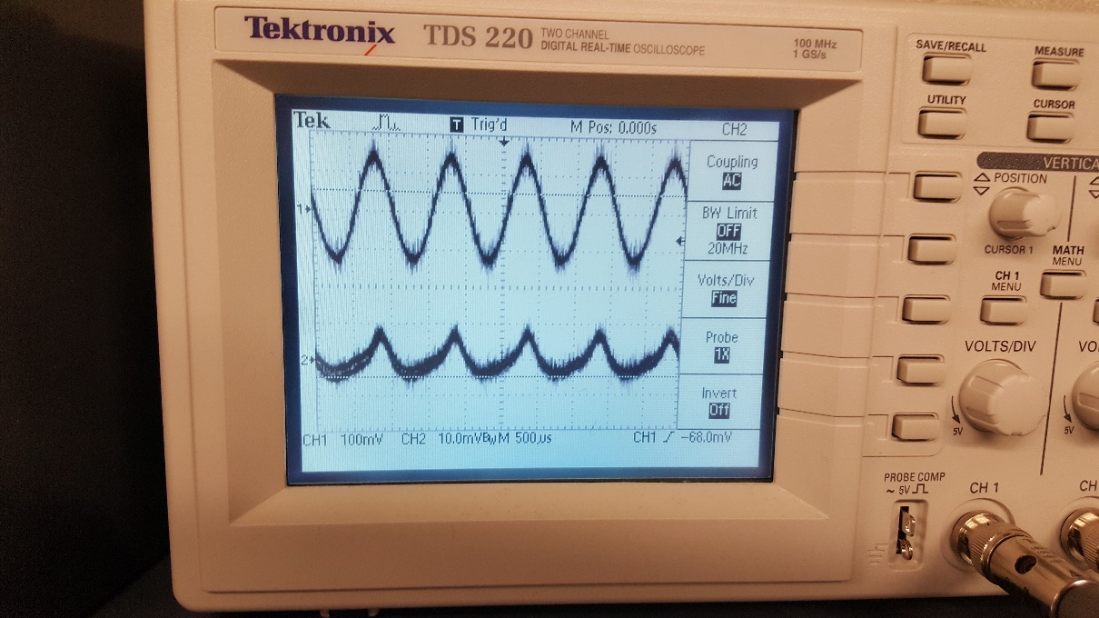
Lab 1 – Switching Diode

Slide 4
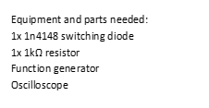
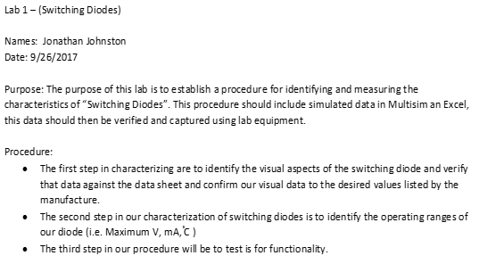
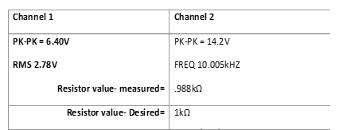
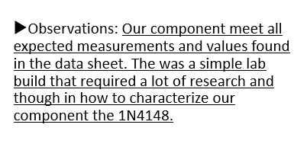
Lab 1 – Switching Diode

Slide 5
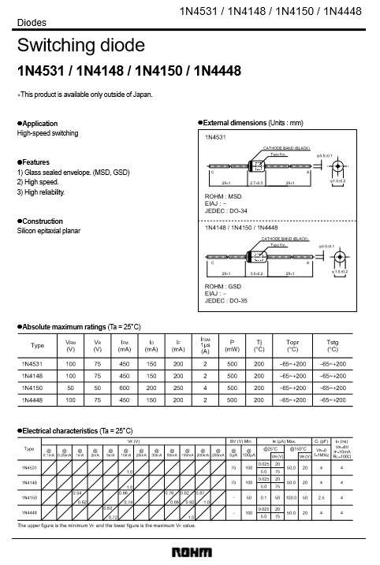
Lab 1 – Switching Diode

Slide 6
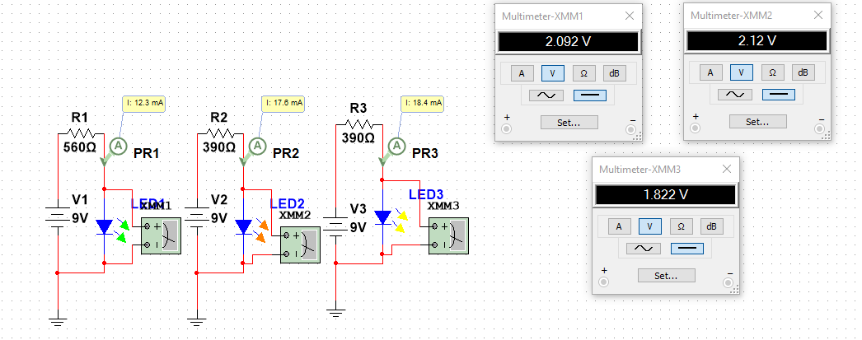
Lab 2 - led

Slide 7
Lab 2 - LED
Green
Simulated | Measured | Simulated | Measured | Simulated | Measured | Simulated | Calculated
Input Voltage (DC) |  | Resistor (Ω) |  | Voltage across LED |  | Currant (mA)
9 | 9.052 | 560 | 554 | 2.092 | 2.043 | 12.355 | 12.7E-3
9 | 9.045 | 680 | 679 | 2.077 | 2.013 | 10.181 | 10.4E-3
9 | 9.045 | 780 | 778 | 2.067 | 1.994 | 8.889 | 9.1E-3
9 | 9.044 | 900 | 897 | 2.056 | 1.974 | 7.717 | 7.9E-3
9 | 9.045 | 1k | 978 | 2.048 | 1.965 | 6.952 | 7.2E-3
Yellow
Simulated | Measured | Simulated | Measured | Simulated | Measured | Simulated | Calculated
Input Voltage (DC) |  | Resistor (Ω) |  | Voltage across LED |  | Currant (mA)
9 | 9.045 | 560 | 554 | 1.803 | 1.995 | 12.852 | 12.7E-3
9 | 9.044 | 680 | 679 | 1.793 | 1.966 | 10.599 | 10.4E-3
9 | 9.047 | 780 | 778 | 1.786 | 1.952 | 9.249 | 9.1E-3
9 | 9.045 | 900 | 897 | 1.778 | 1.934 | 8.024 | 7.9E-3
9 | 9.043 | 1k | 978 | 1.773 | 1.928 | 7.227 | 7.3E-3
Amber
Simulated | Measured | Simulated | Measured | Simulated | Measured | Simulated | Calculated
Input Voltage (DC) |  | Resistor (Ω) |  | Voltage across LED |  | Currant (mA)
9 | 9.045 | 560 | 554 | 1.803 | 1.863 | 12.852 | 13.0E-3
9 | 9.041 | 680 | 679 | 1.793 | 1.835 | 10.599 | 10.6E-3
9 | 9.043 | 780 | 778 | 1.786 | 1.827 | 9.249 | 9.3E-3
9 | 9.046 | 900 | 897 | 1.778 | 1.804 | 8.024 | 8.1E-3
9 | 9.042 | 1k | 978 | 1.773 | 1.796 | 7.227 | 7.4E-3

Slide 8
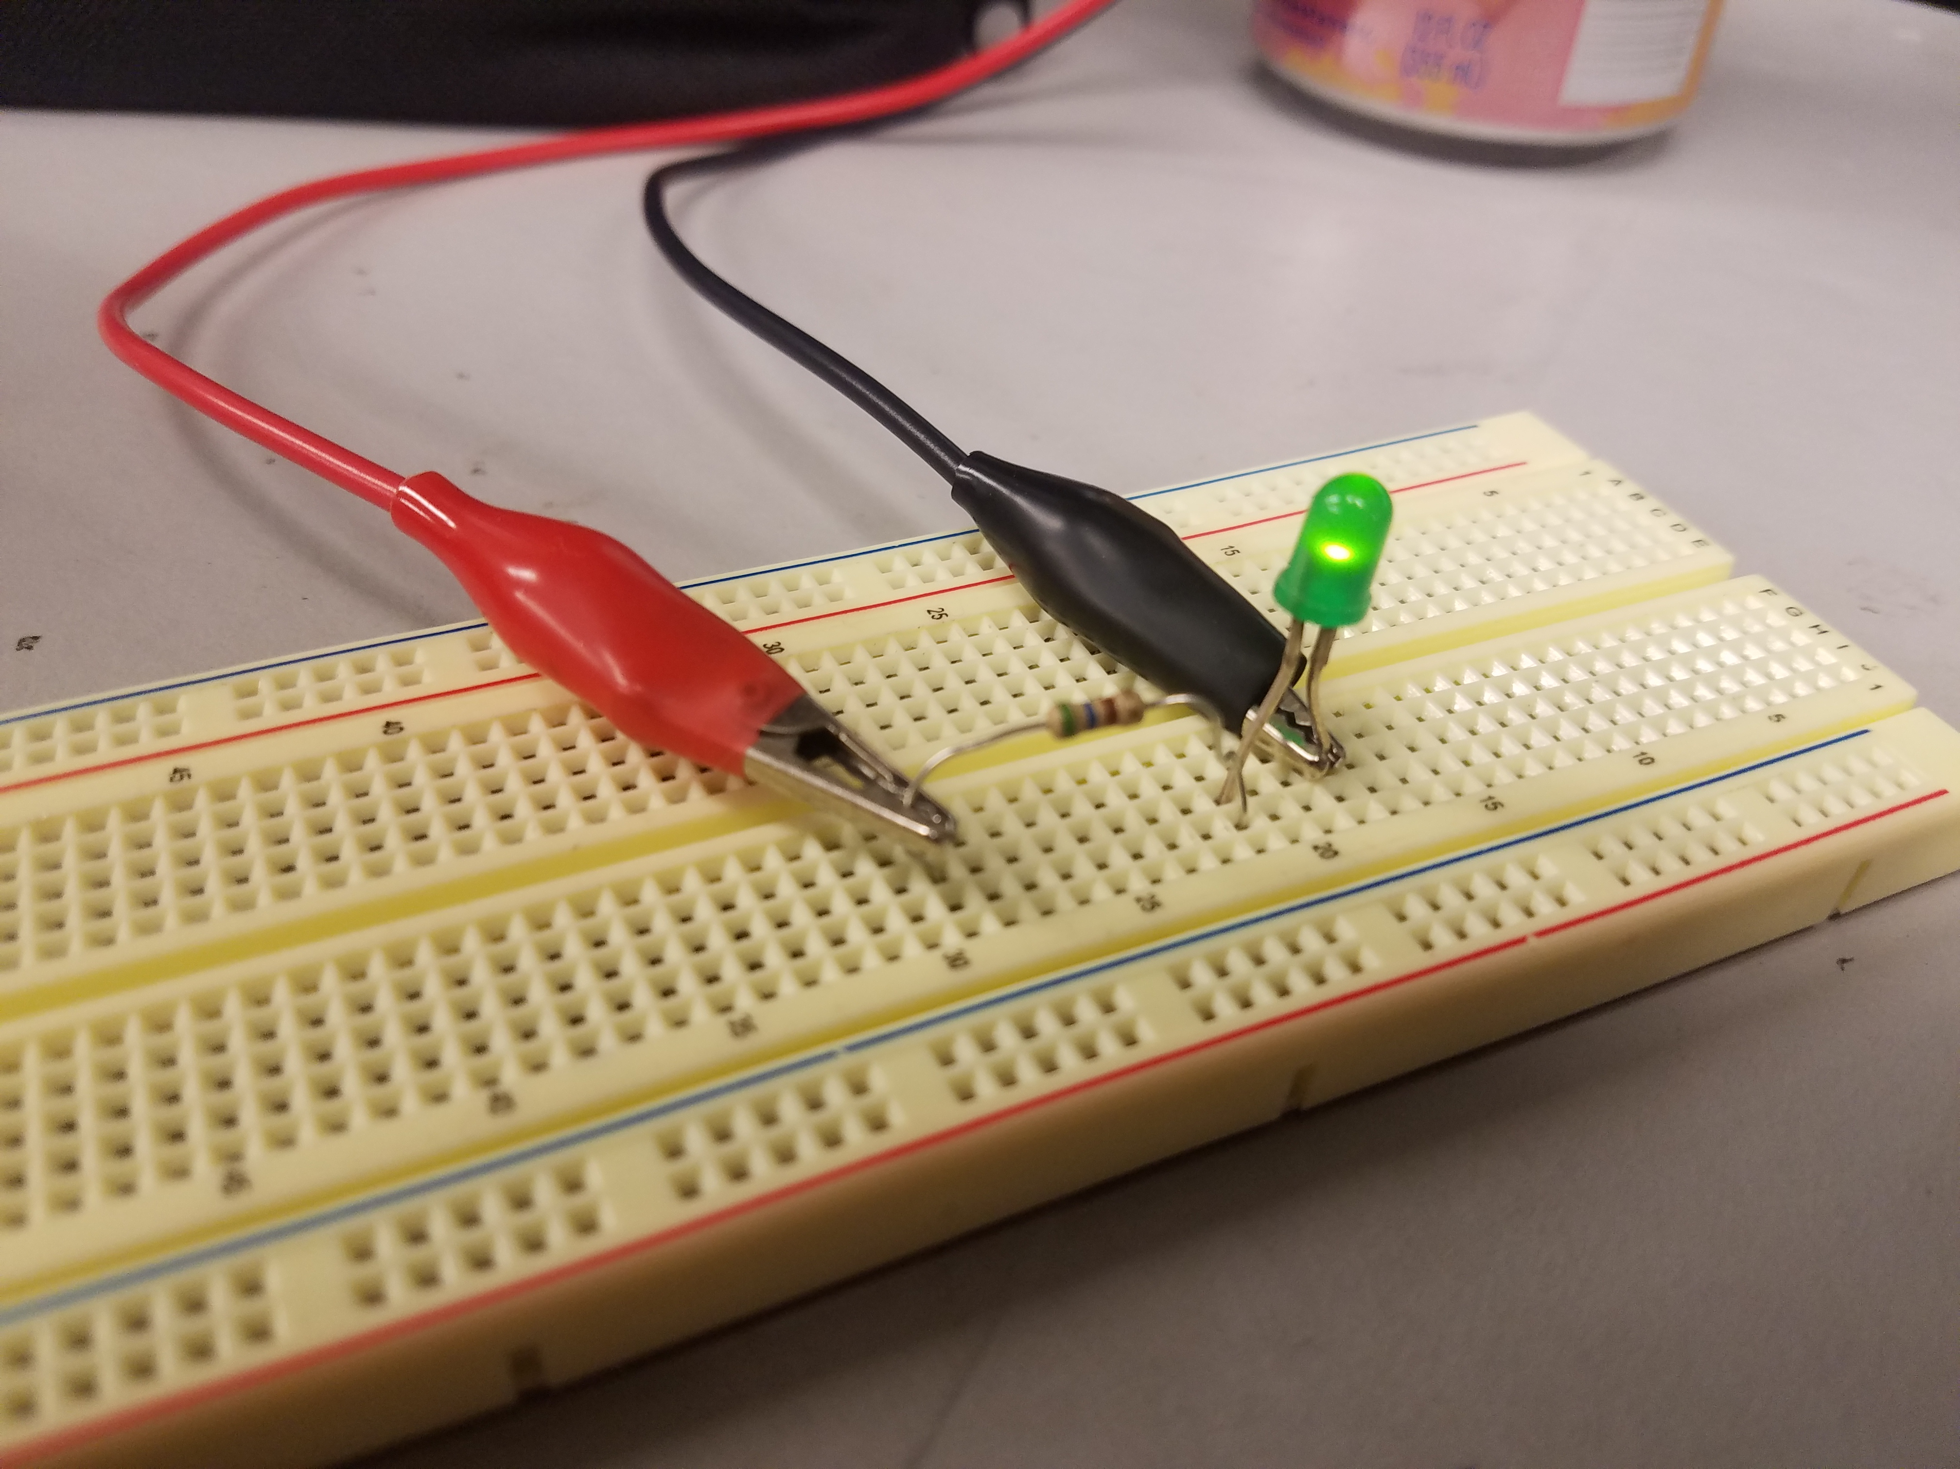
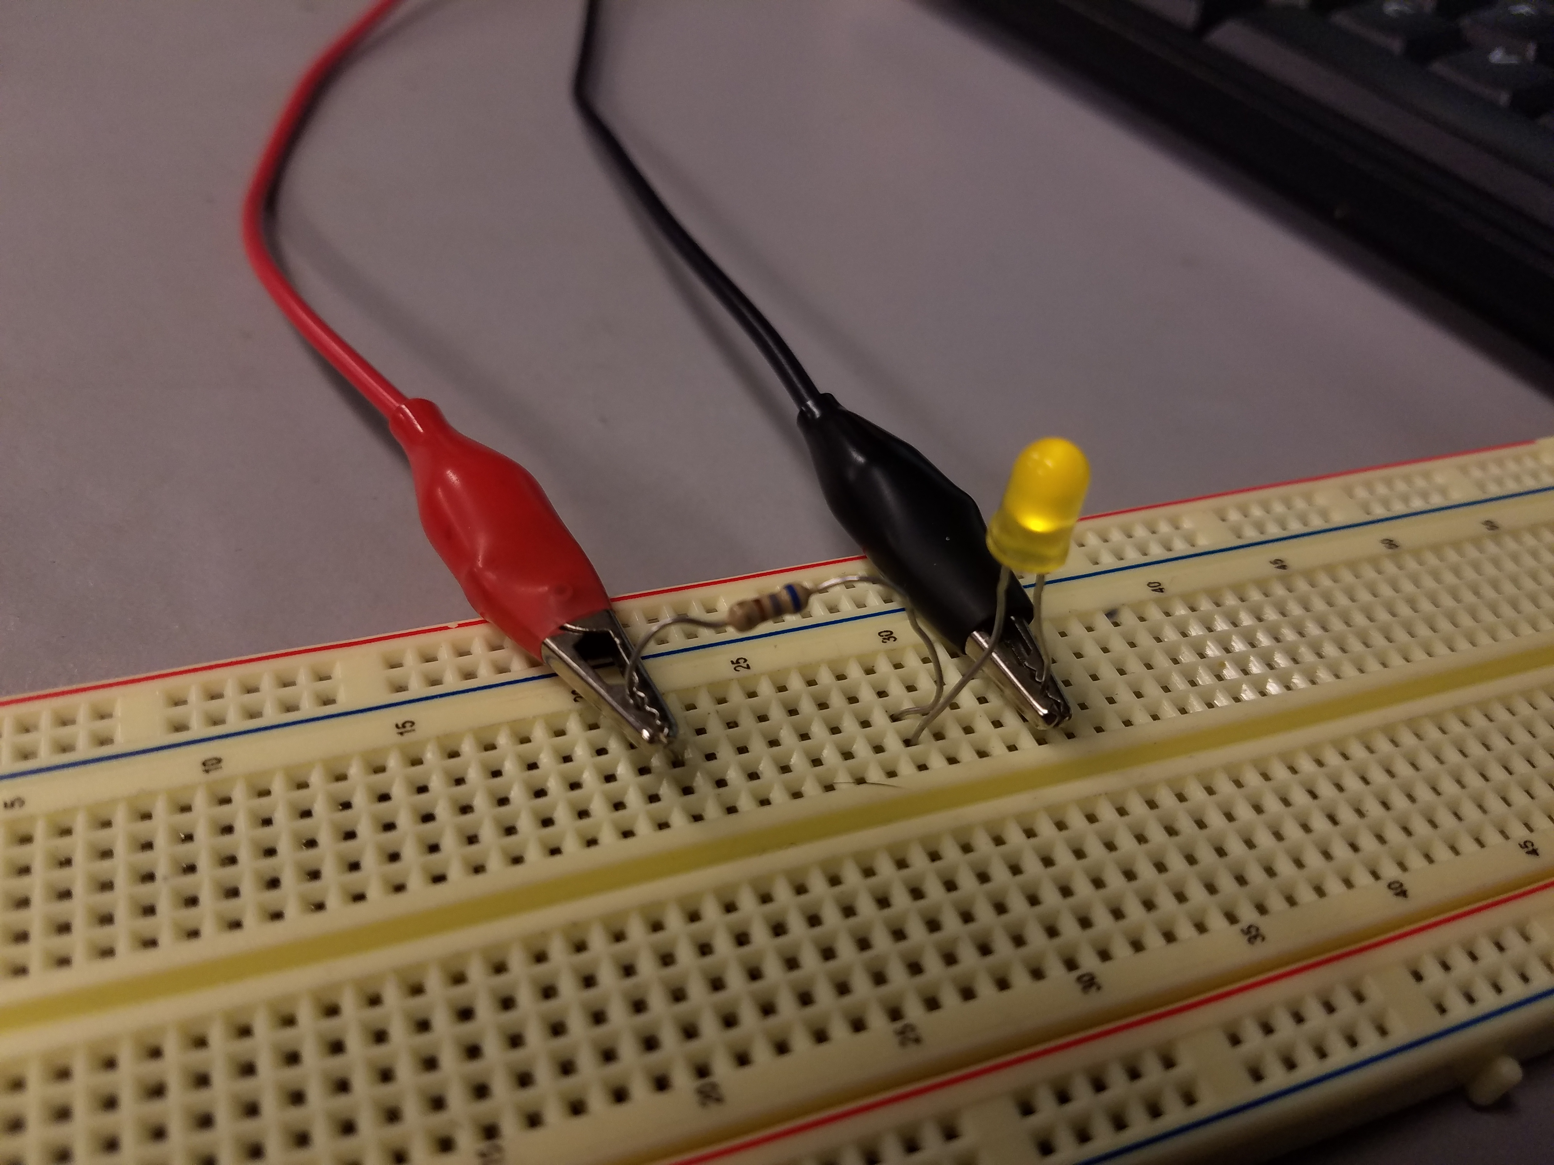
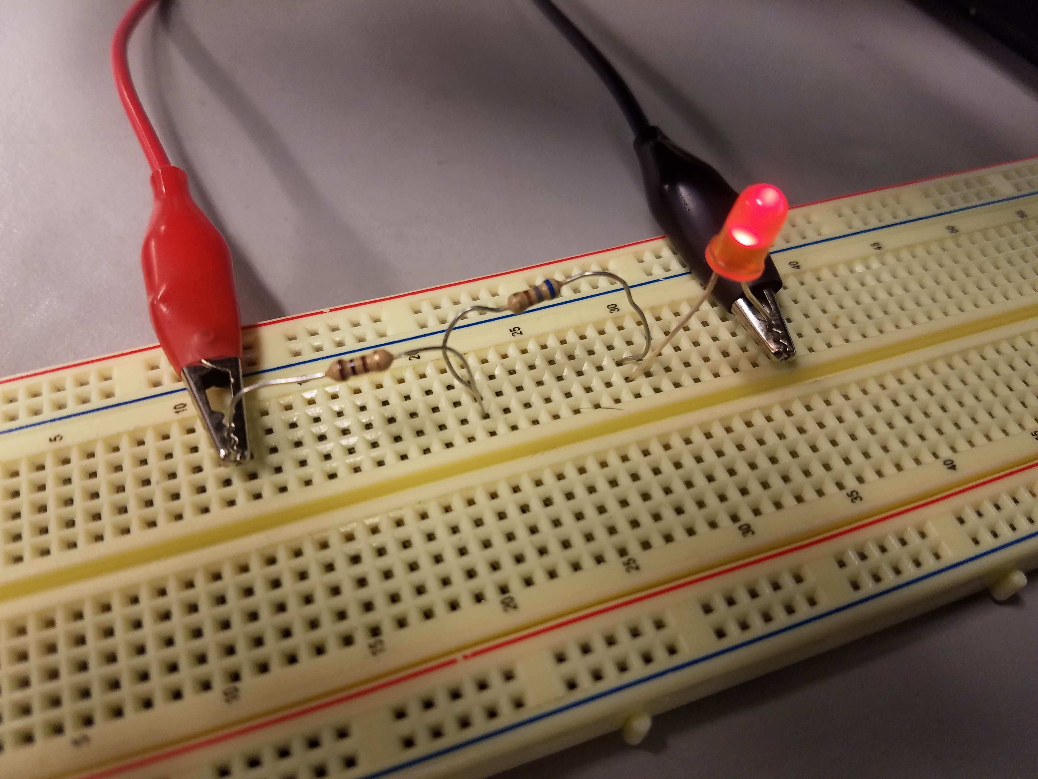
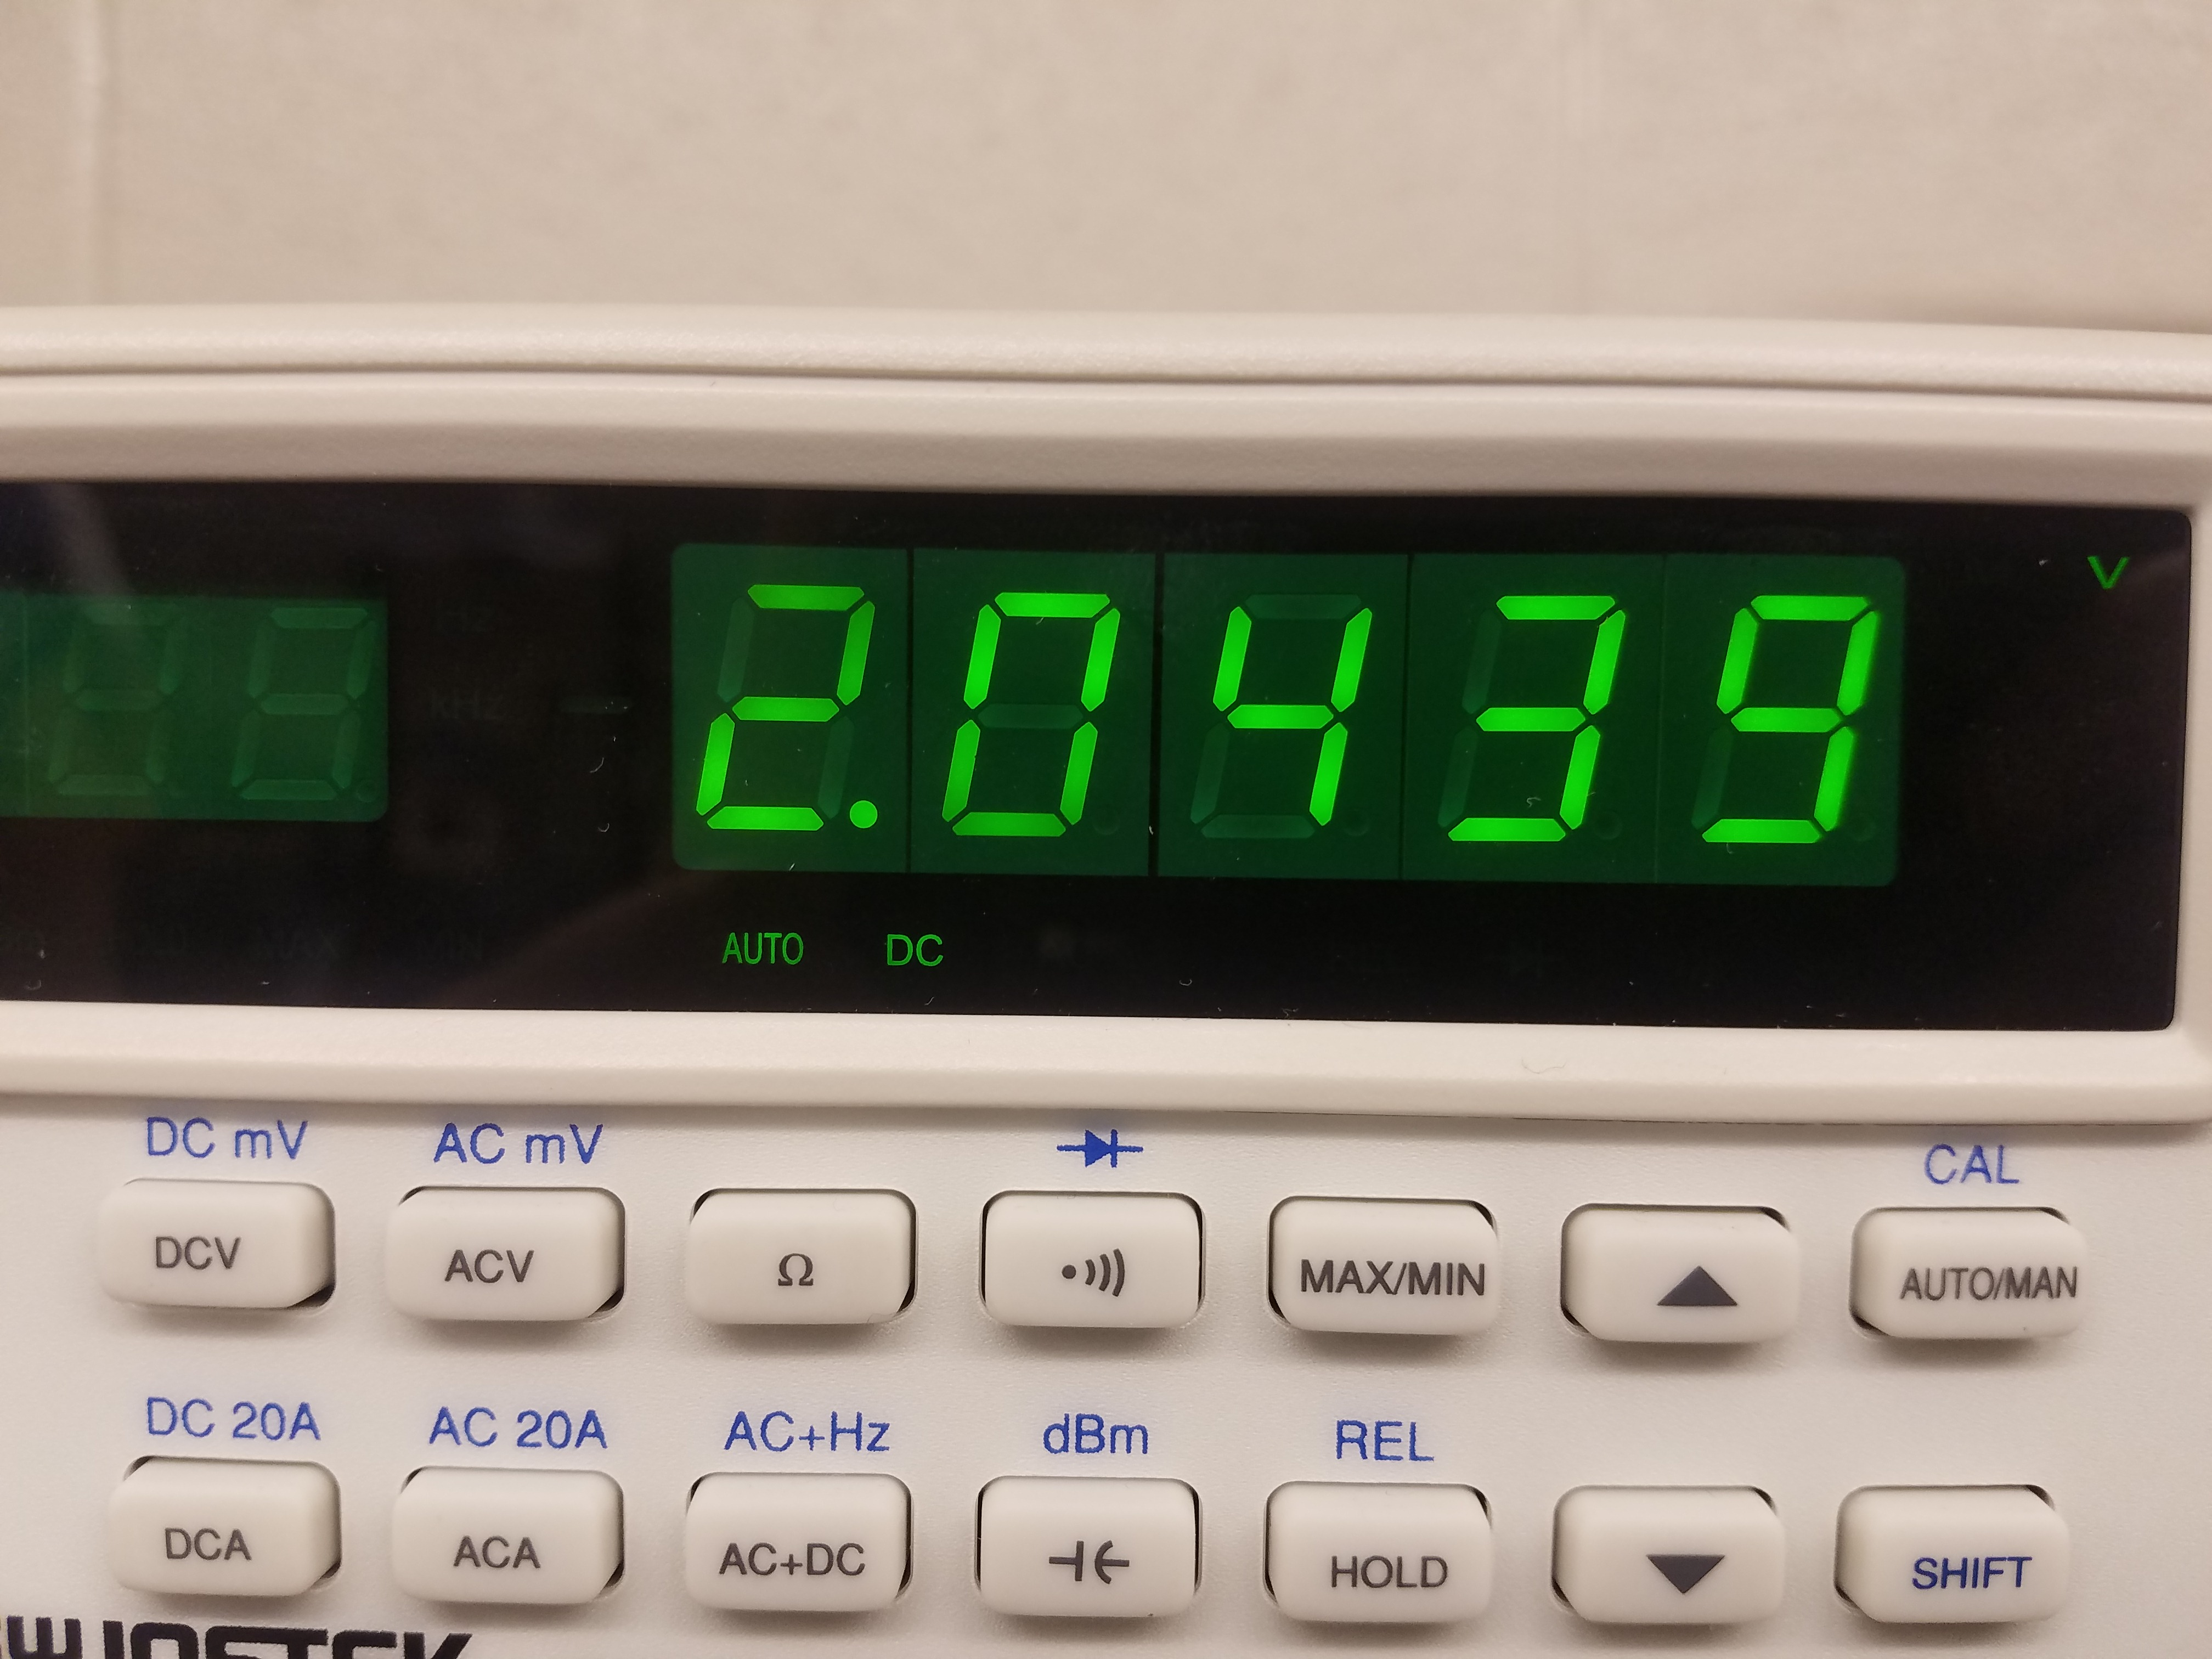
Lab 2 - LED

Slide 9
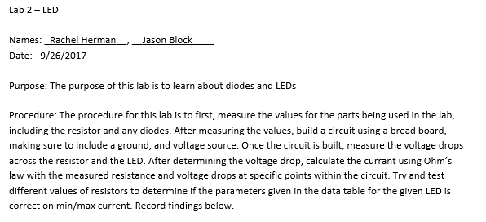
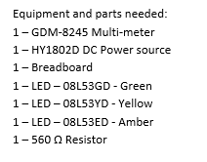
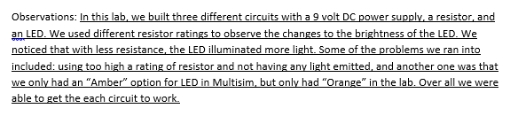
Lab 2 - LED

Slide 10
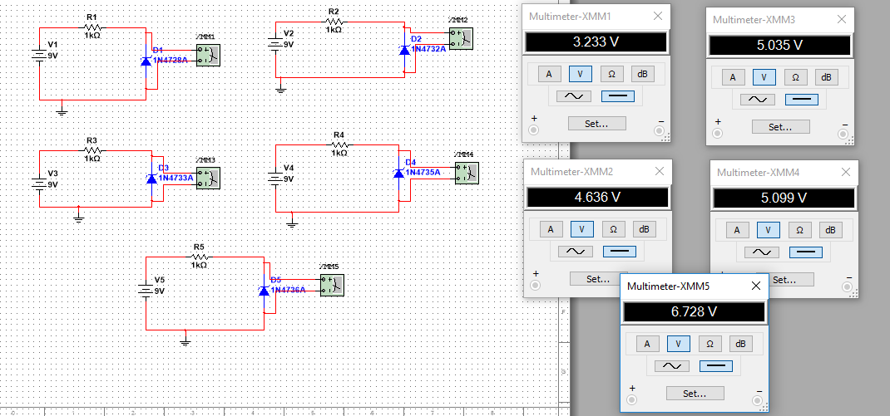
Lab 3 – Zener Diode

Slide 11
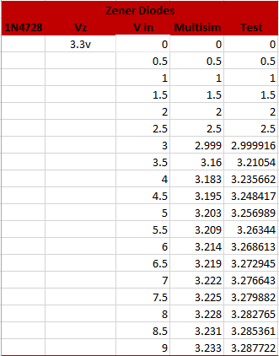
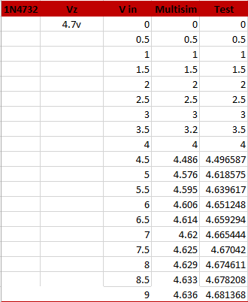
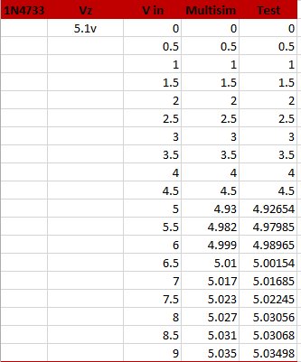
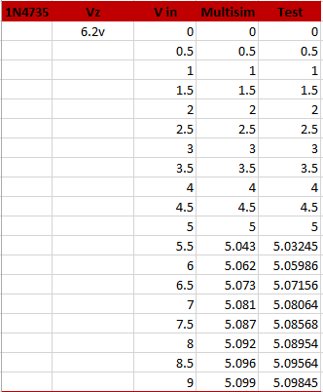
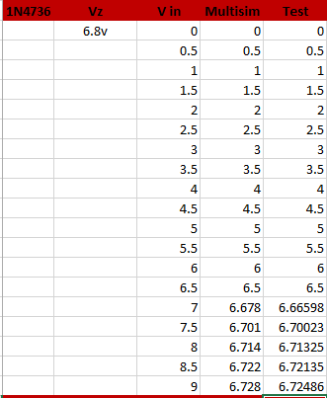
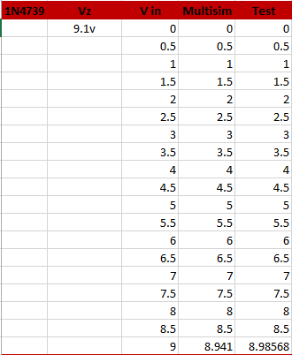
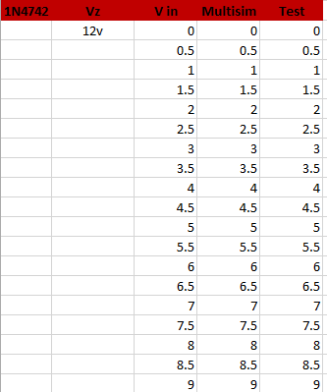
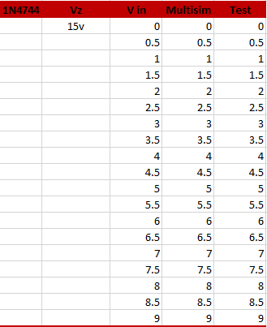
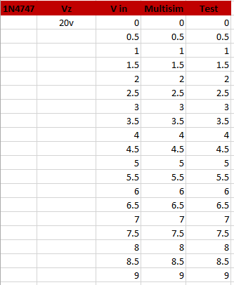
Lab 3 – Zener Diode

Slide 12
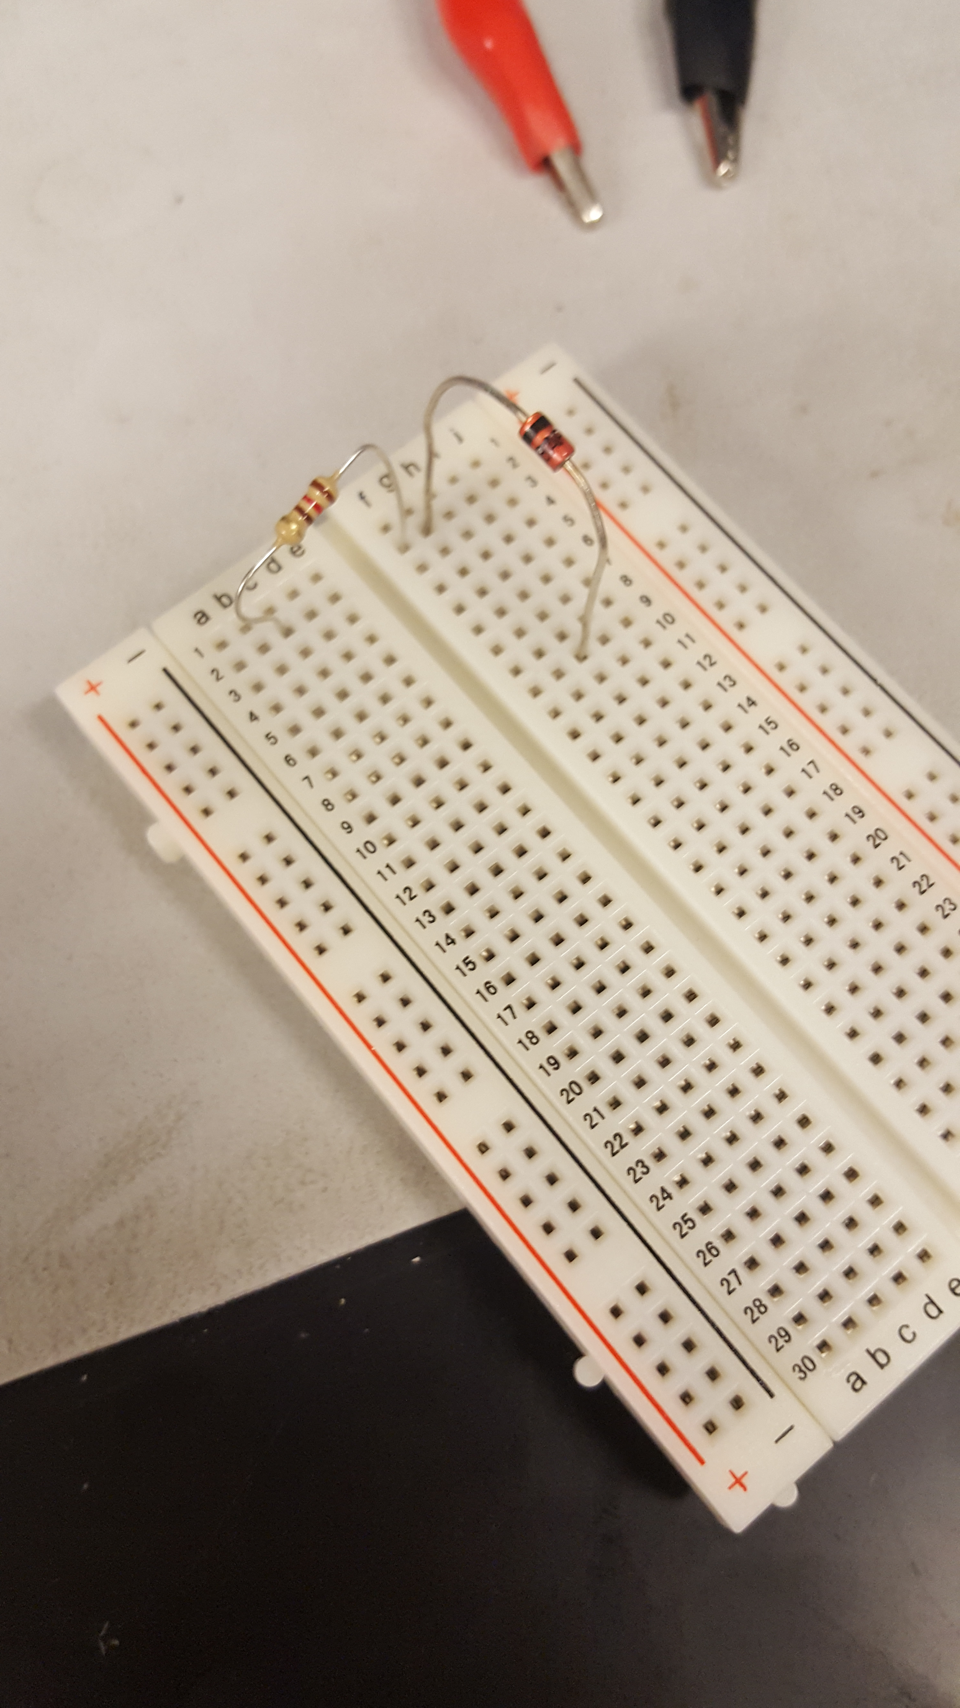
Lab 3 – Zener Diode

Slide 13
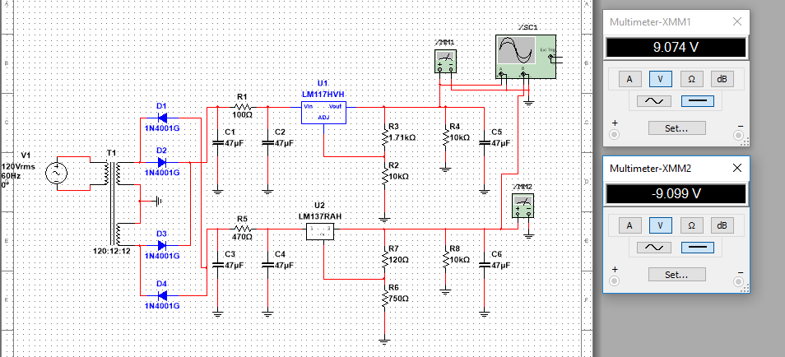
Lab 4 – Duel Power Supply

Slide 14
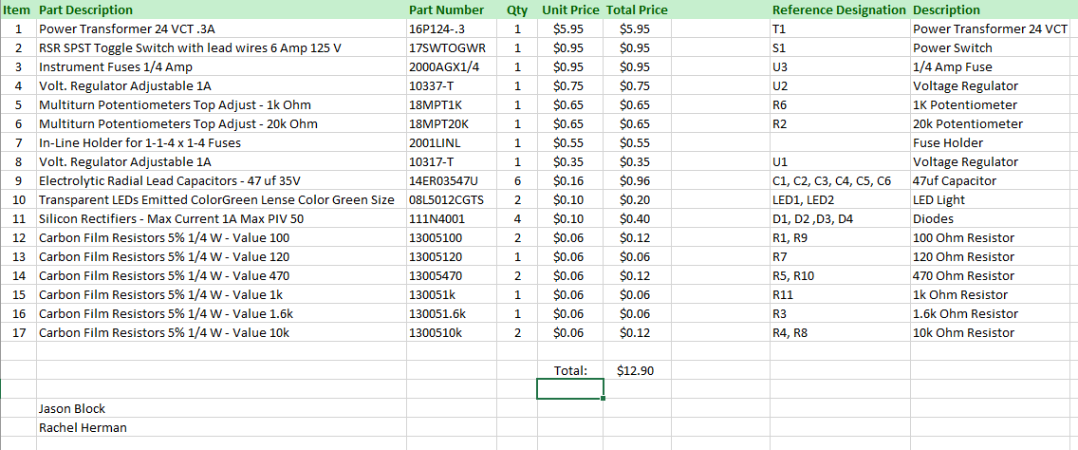
Lab 4 – duel Power Supply

Slide 15
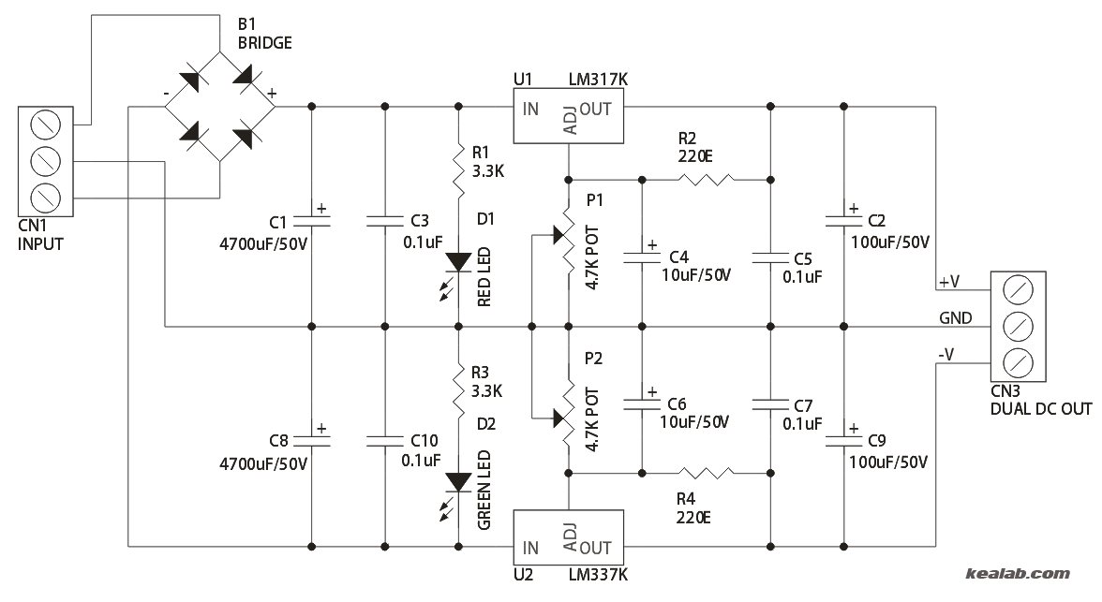
Lab 4 – Duel Power Supply

Slide 16
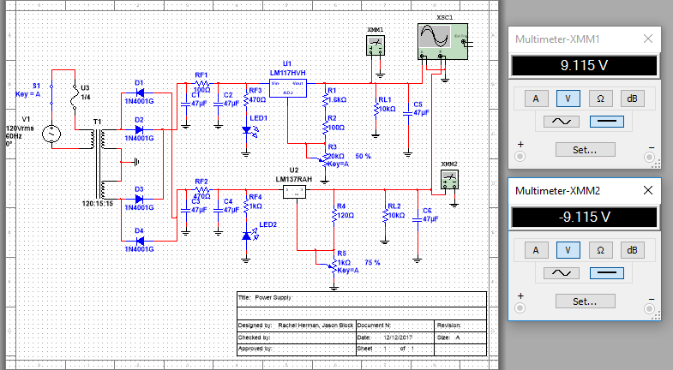
Lab 4 – duel power supply

Slide 17
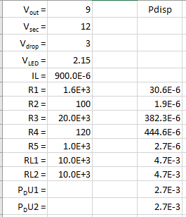
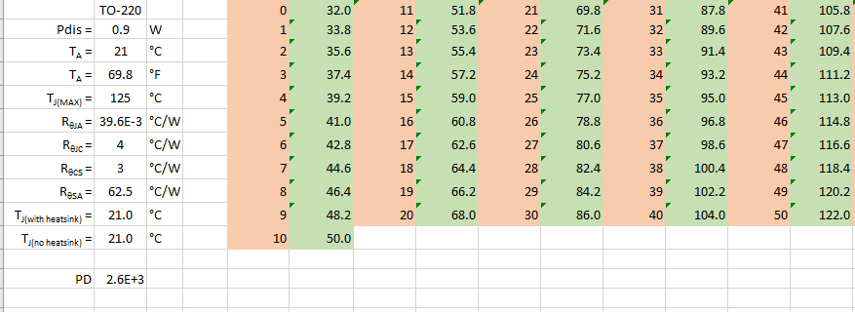
Lab 4 – Duel Power Supply

Slide 18
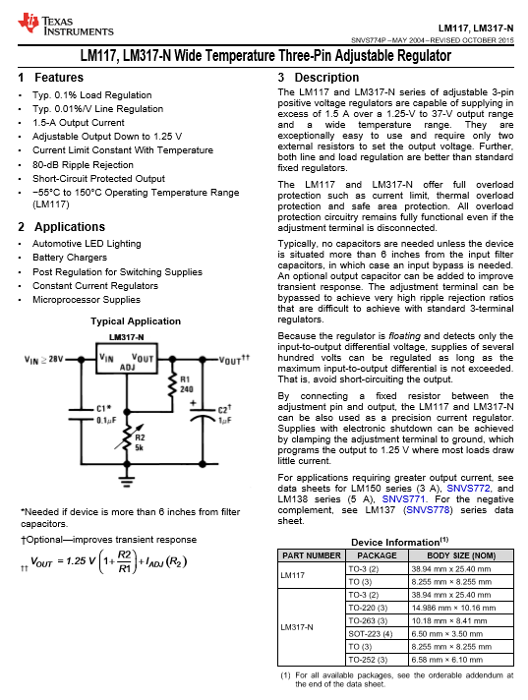
Lab 4 – Duel Power Supply

Slide 19
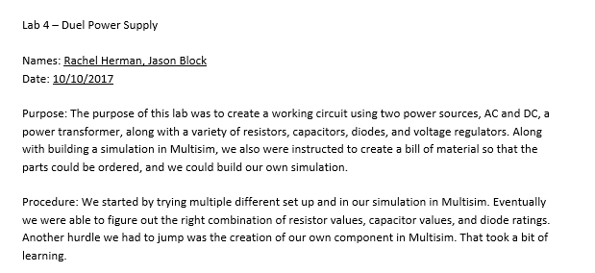

Lab 4 – Duel Power Supply

Slide 20
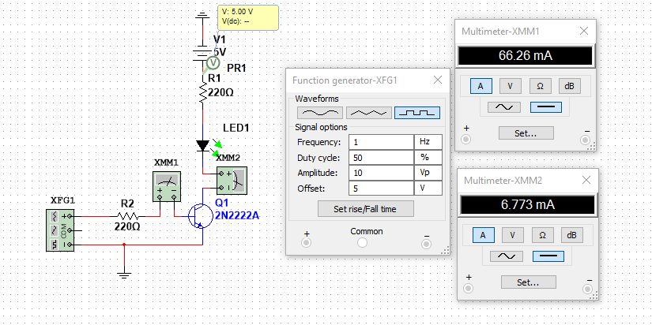
Lab 5 – Transistor Switch

Slide 21
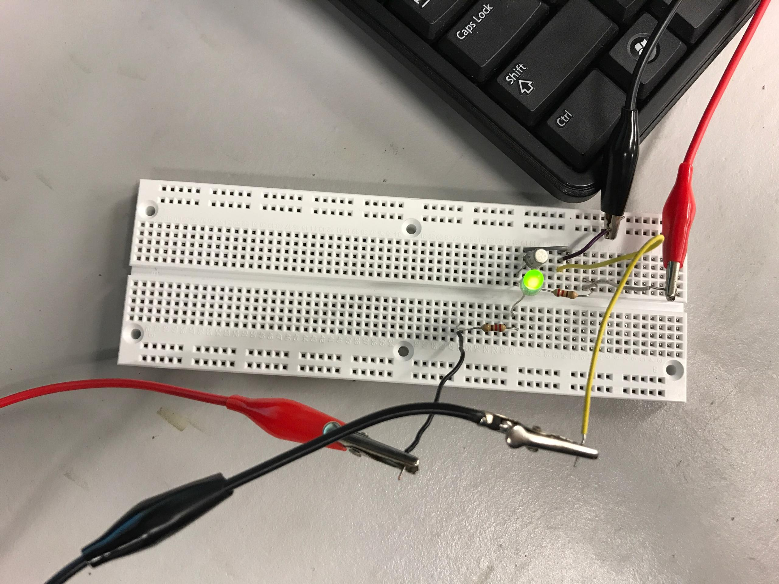
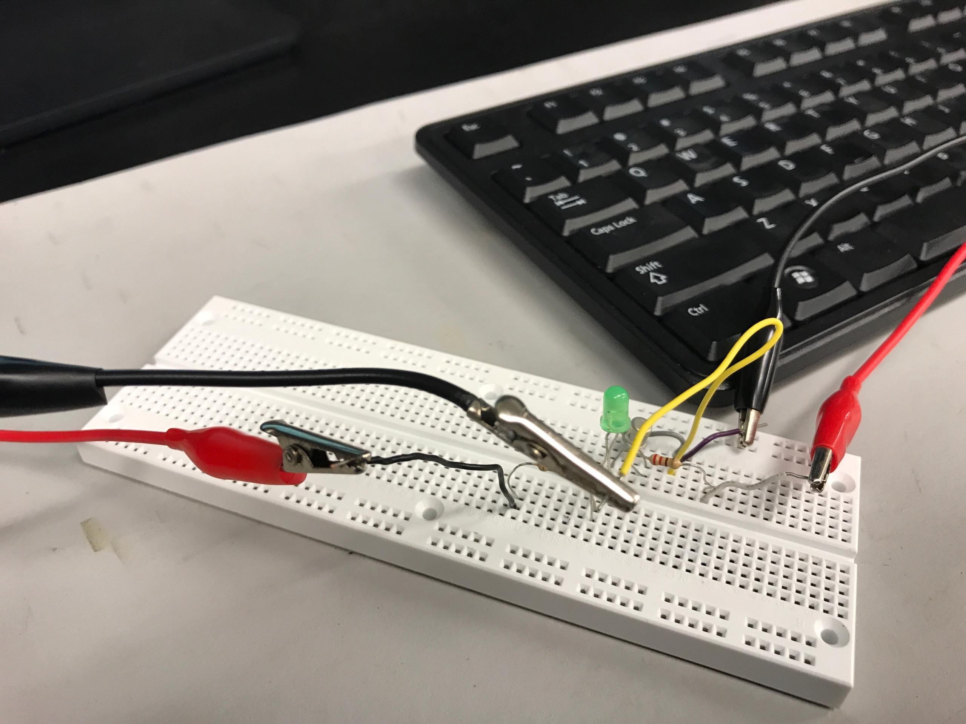
Lab 5 –Transistor Switch

Slide 22
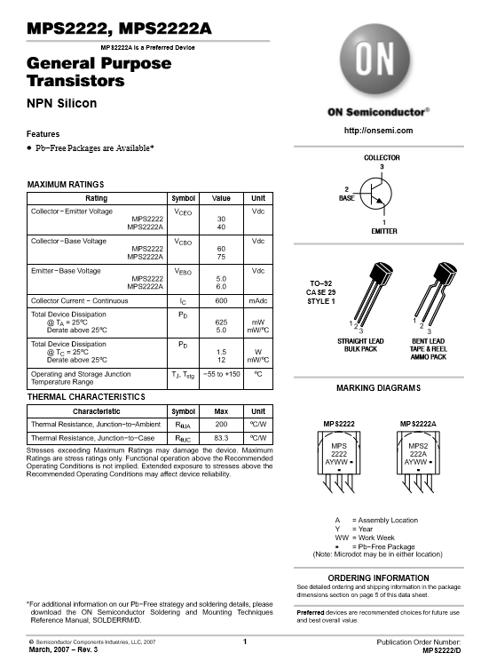
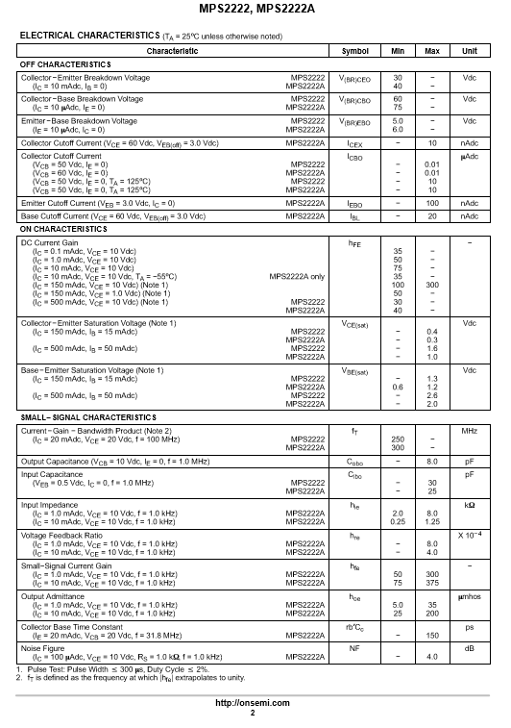
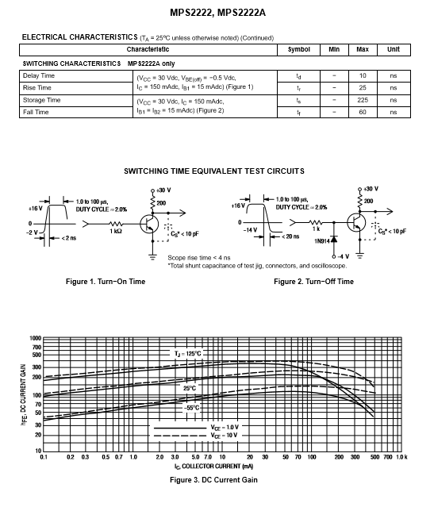
Lab 5 – Transistor switch

Slide 23
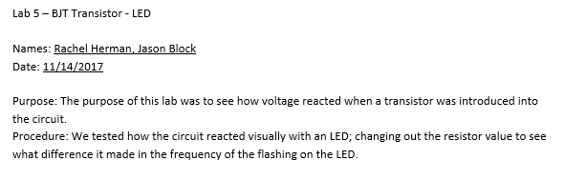
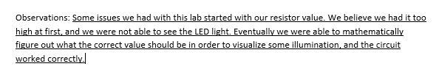
Lab 5 – Transistor Switch

Slide 24
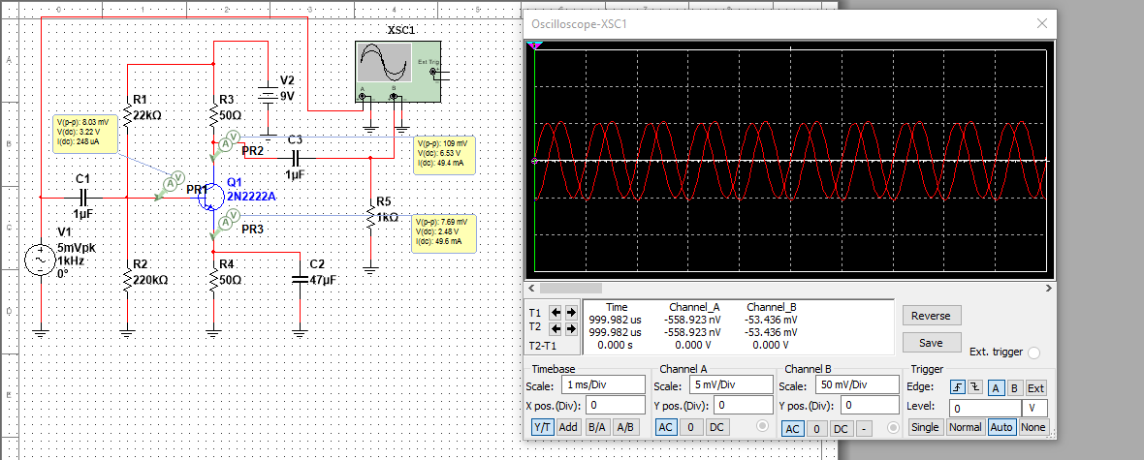
Lab 6 – Transistor amplifier

Slide 25
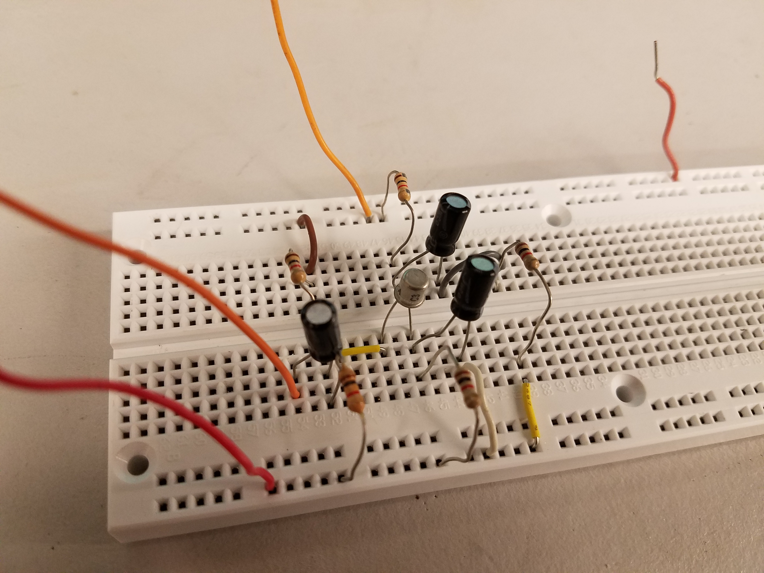
Lab 6 – Transistor Amplifier

Slide 26
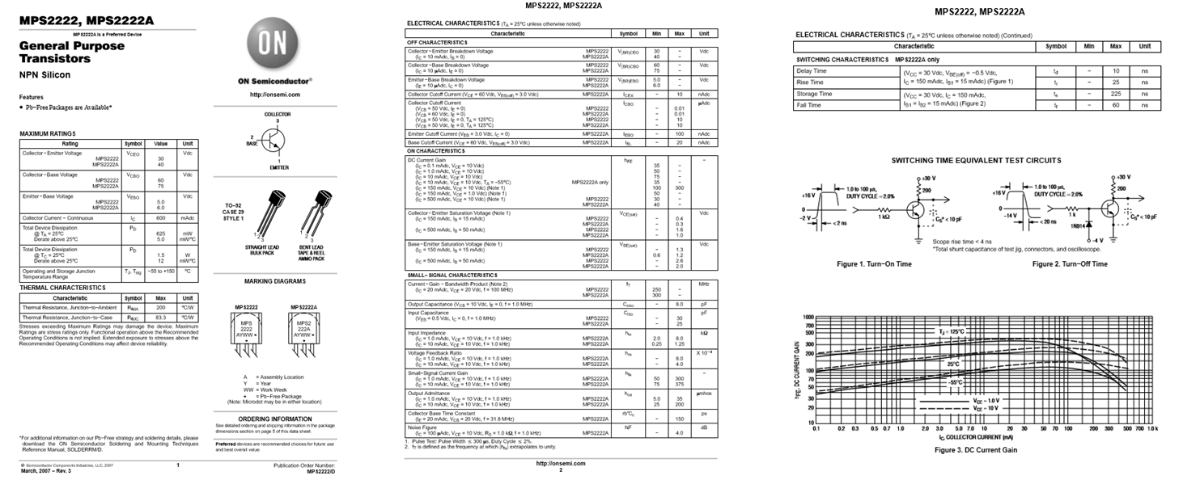
Lab 6 – Transistor Amplifier

Slide 27
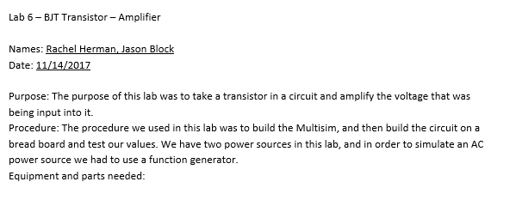

Lab 6 – Transistor amplifier

Slide 28
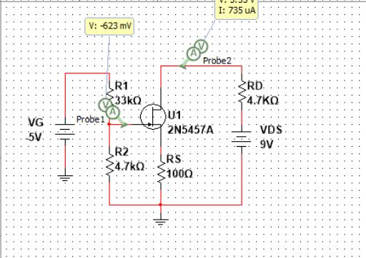
Lab 7 – jfet switch

Slide 29
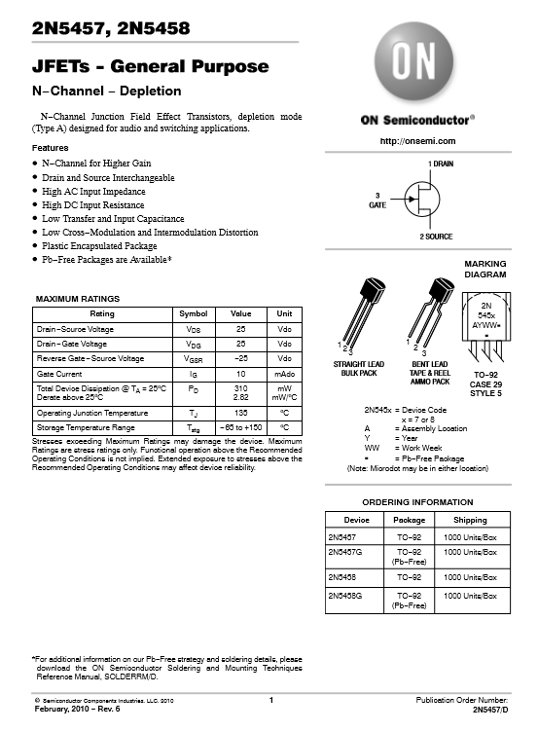


Lab 7 – jfet switch

Slide 30


Lab 7 – jfet switch

Slide 31

Lab 8 – jfet amplifier

Slide 32



Lab 8 – jfet amplifier

Slide 33
Lab 8 – jfet amplifier

Slide 34


Lab 8 – jfet amplifier

Slide 35

Lab 9 – Low Pass Filter

Slide 36
Lab 9 – Low Pass Filter

Slide 37



Lab 9 – Low Pass Filter

Slide 38

Lab 10 – high pass filter

Slide 39
Lab 10 – High pass filter

Slide 40

Lab 10 – high pass filter

Slide 41

Lab 11 – band pass filter

Slide 42
Lab 11 – band pass filter

Slide 43
Lab 11 – band pass filter

Slide 44

Lab 12 – twin-t filter

Slide 45
Lab 12 – twin-t filter

Slide 46
Lab 12 – twin-t filter

Slide 47
Thanks!

